Slide 1


Adaptive Holding for Online Bottleneck Matching with Delays
Kaixin Wang¹, Cheng Long¹, Yongxin Tong², Jie Zhang¹, Yi Xu²
¹Nanyang Technological University, Singapore
²Beihang University, China
31 March 2021
Notes:
Today, I will give a presentation on the topic of “Adaptive holding for online bottleneck matching with delays”.

Slide 2
Outline
Introduction
Theoretical results
Solution
Experimental results
Conclusion
Notes:
Here is the outline.

Slide 3




Introduction
Bipartite Matching is ubiquitous.
  Applications
  Online
    Objects to be matched arrive dynamically;
    Future information is not available.
Assign requests to drivers.
Assign orders to couriers.
Notes:
First, I will present the background and the motivation of our problem.
Bipartite matching is common in real lives. It is used in various emerging applications, ranging from ride hailing platforms, to food delivery services.
In all these applications, objects to be matched is arriving dynamically in an online fashion, where the information about the objects that would appear in the future is not available.

Slide 4
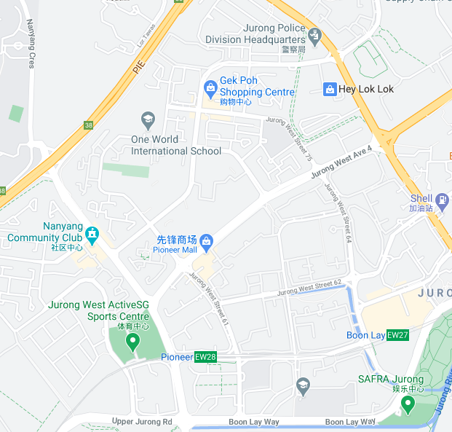
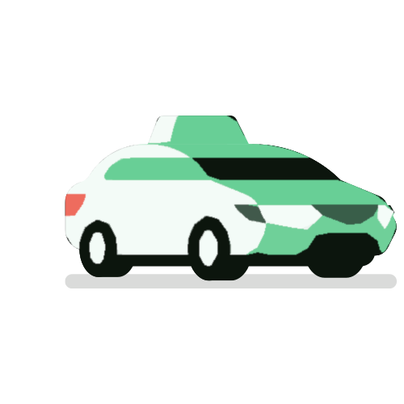
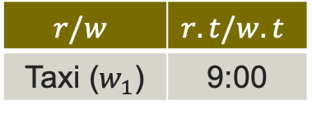

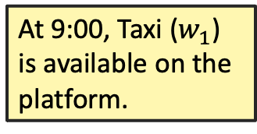
Introduction
Delay-aware
  Cost of a match relies on when it is assigned;
  Focus on the maximum match cost, i.e., bottleneck cost;
$$w_{1}$$
$$r/w$$ | $$r.t/w.t$$
Taxi ($w_{1}$) | 9:00
At 9:00, Taxi ($w_{1}$) is available on the platform.
Notes:
Based on these applications, different objectives have been studied. One of them is a delay-aware problem, in which we focus on the bottleneck cost. [click]
Now I will present an example in taxi dispatching scenario. Here is a map of a part of Singapore. [click]
At 9:00, a taxi is available on the platform. [click]

Slide 5
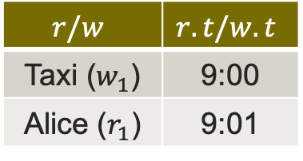
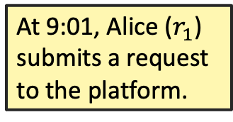
Introduction
Delay-aware
  Cost of a match relies on when it is assigned;
  Focus on the maximum match cost, i.e., bottleneck cost;
$$w_{1}$$
$$r/w$$ | $$r.t/w.t$$
Taxi ($w_{1}$) | 9:00
Alice ($r_{1}$) | 9:01
Alice
At 9:01, Alice ($r_{1}$) submits a request to the platform.
Notes:
At 9:01, Alice submits a request to the platform, and the taxi moves some distance. [click]

Slide 6


Introduction
Delay-aware
  Cost of a match relies on when it is assigned;
  Focus on the maximum match cost, i.e., bottleneck cost;
$$w_{1}$$
$$r/w$$ | $$r.t/w.t$$
Taxi ($w_{1}$) | 9:00
Alice ($r_{1}$) | 9:01
Alice
At 9:03, platform assigns taxi ($w_{1}$) to Alice ($r_{1}$).
They form a match ($r_{1}$, $w_{1}$, 9:03).
Notes:
After 2 minutes, say at 9:03, the platform assigns the taxi to Alice. So, they form a match ($r_{1}, w_{1}$, 9:03). [click].

Slide 7

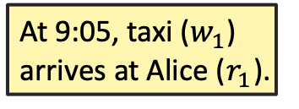
Introduction
The cost of the match ($r_{1}, w_{1}$, 9:03) is the time delay between her submission of the request and the arrival of the taxi, i.e., (9:05 – 9:03) + (9:03 – 9:01) = 4min.
Delay-aware
  Cost of a match relies on when it is assigned;
  Focus on the maximum match cost, i.e., bottleneck cost;
$$r/w$$ | $$r.t/w.t$$
Taxi ($w_{1}$) | 9:00
Alice ($r_{1}$) | 9:01
$$w_{1}$$
Alice
At 9:05, taxi ($w_{1}$) arrives at Alice ($r_{1}$).
Notes:
Finally, at 9:05, taxi arrives at Alice’s location. [click]
Then, we define that the cost of the match in the taxi dispatching scenario is the time delay between the submission of the request and the arrival of the taxi. For Alice, the cost of the match for her is 4 minutes. [click]

Slide 8
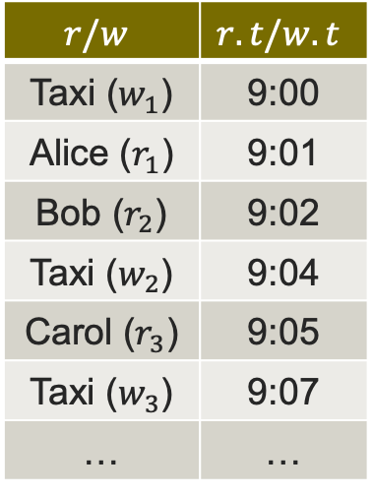

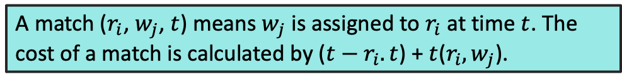
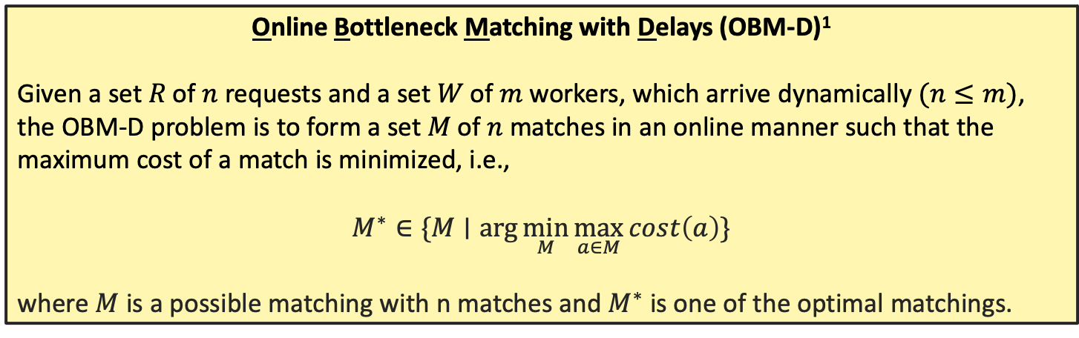

Introduction
$$w_{2}$$
A match ($r_{i}$, $w_{j}$, $t$) means $w_{j}$ is assigned to $r_{i}$ at time $t$. The cost of a match is calculated by ($t−r_{i}.t$) + $t$($r_{i}, w_{j}$).
Delay-aware
  Cost of a match relies on when it is assigned;
  Focus on the maximum match cost, i.e., bottleneck cost;
$$w_{1}$$
Carol
$$r/w$$ | $$r.t/w.t$$
Taxi ($w_{1}$) | 9:00
Alice ($r_{1}$) | 9:01
Bob ($r_{2}$) | 9:02
Taxi ($w_{2}$) | 9:04
Carol ($r_{3}$) | 9:05
Taxi ($w_{3}$) | 9:07
… | …
Online Bottleneck Matching with Delays (OBM-D)¹
Given a set 𝑅 of 𝑛 requests and a set 𝑊 of 𝑚 workers, which arrive dynamically $(n≤m)$, the OBM-D problem is to form a set 𝑀 of 𝑛 matches in an online manner such that the maximum cost of a match is minimized, i.e.,
$$M^{∗}∈\{M∣\arg{\min_{M}{\max_{a∈M}{cost\left(a\right)}}}\}$$
where $M$ is a possible matching with n matches and $M^{∗}$ is one of the optimal matchings.
$$w_{3}$$
Alice
Bob
¹Chen, Zhao, et al. "Minimizing maximum delay of task assignment in spatial crowdsourcing.” In ICDE 2019.
Notes:
Above is a simple example with only one user and one taxi. However, in real scenario, there will be a large number of users and taxis arriving dynamically as the table shows. [click]
Thus, in taxi dispatching scenario, the online bottleneck matching with delays is defined as: given a set of n requests, and a set of m drivers (or we call the workers), which arrive dynamically, the OBM-D is to form a set of n matches in an online manner such that the maximum cost of a match is minimized.

Slide 9
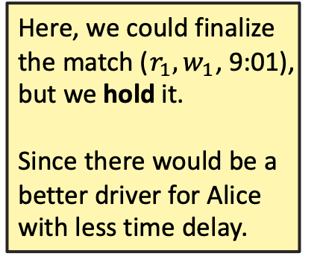
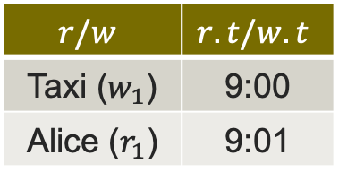
Introduction
Holding strategy
  When a match is formed, don’t finalize it; instead, hold it;
$$r/w$$ | $$r.t/w.t$$
Taxi ($w_{1}$) | 9:00
Alice ($r_{1}$) | 9:01
$$w_{1}$$
Here, we could finalize the match ($r_{1}, w_{1}$, 9:01), but we hold it.
Since there would be a better driver for Alice with less time delay.
Alice
Notes:
Some studies adopted a holding strategy in their algorithm design. It means that when a match forms, we do not finalize it immediately, instead, we hold it for a while. [click]
Use the same example. [click]
At 9:01, Here, we could finalize the match ($r_{1}, w_{1}$, 9:01), but we hold it, since there would be a better driver for Alice with less time delay. [click]

Slide 10
Introduction
Holding strategy
  When a match is formed, don’t finalize it; instead, hold it;
  Effective
    Proved by previous work^{1,2};
    Rule-based heuristics, benefits not fully unleashed;
¹Li, Long, et al. "Spatial bottleneck minimum task assignment with time-delay.” In DASFAA 2019.
²Chen, Zhao, et al. "Minimizing maximum delay of task assignment in spatial crowdsourcing.” In ICDE 2019.
Notes:
Existing work has proved that holding strategy is effective, but they are all rule-based heuristics, so the benefits of holding strategy are not fully unleashed. [click]

Slide 11
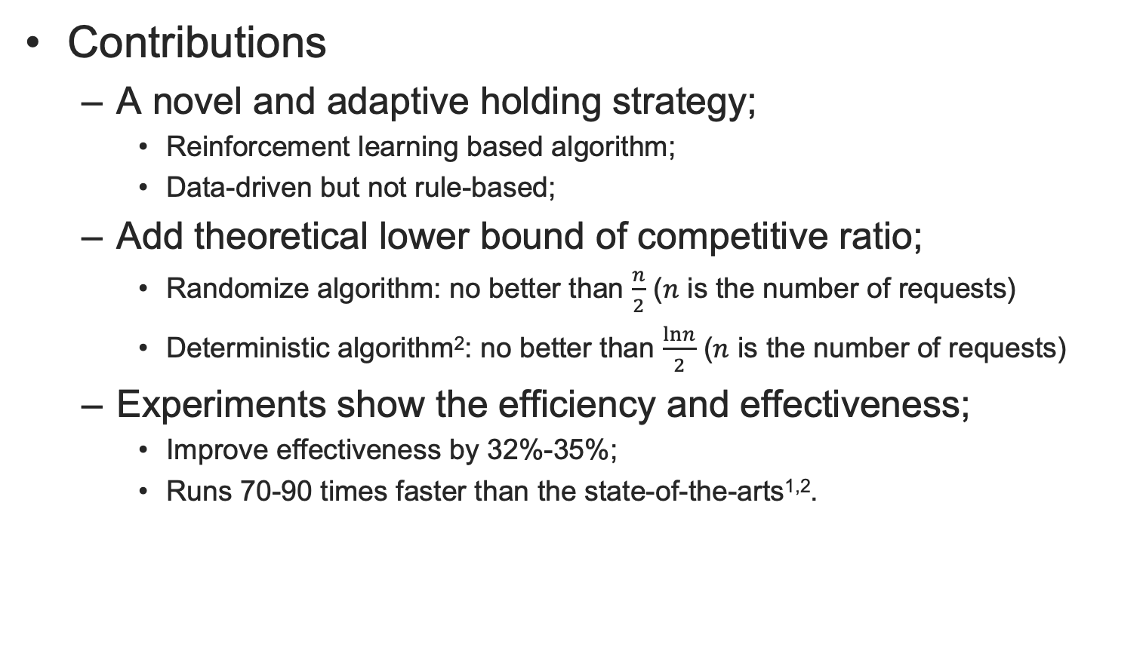
Introduction
Contributions
  A novel and adaptive holding strategy;
    Reinforcement learning based algorithm;
    Data-driven but not rule-based;
  Add theoretical lower bound of competitive ratio;
    Randomize algorithm: no better than $\frac{n}{2}$ ($n$ is the number of requests)
    Deterministic algorithm²: no better than $\frac{lnn}{2}$ ($n$ is the number of requests)
  Experiments show the efficiency and effectiveness;
    Improve effectiveness by 32%-35%;
    Runs 70-90 times faster than the state-of-the-arts^{1,2}.
¹Li, Long, et al. "Spatial bottleneck minimum task assignment with time-delay.” In DASFAA 2019.
²Chen, Zhao, et al. "Minimizing maximum delay of task assignment in spatial crowdsourcing.” In ICDE 2019.
Notes:
Thus, in this paper, we made such contributions
Firstly, we design a novel and adaptive holding strategy.
Secondly, we give a theoretical lower bound of competitive ratio for randomize algorithm.
Finally, we conduct extensive experiments to show the efficiency and the effectiveness.

Slide 12
Outline
Introduction
Theoretical results
Solution
Experimental results
Conclusion
Notes:
We first present some theoretical results for online bottleneck matching with delays problem. [click]

Slide 13

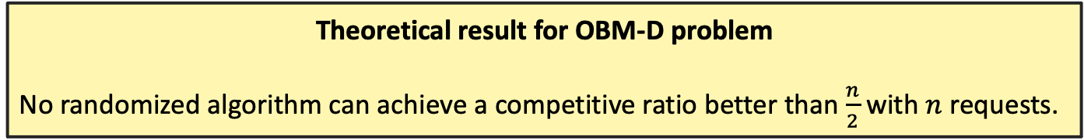
Theoretical results
Competitive ratio ($cr$)
  Performance measurement of an online algorithm;
    Randomized algorithm: $cr=\max_{x∈𝒳}\frac{𝔼[obj(A(x))]}{obj(M^{∗}(x))}$
    Deterministic algorithm: $cr=\max_{x∈𝒳}\frac{obj(A(x))}{obj(M^{∗}(x))}$
  Under OBM-D problem, the lower the better;
Theoretical result for OBM-D problem
No randomized algorithm can achieve a competitive ratio better than $\frac{n}{2}$ with $n$ requests.
Notes:
To measure an online algorithm, the competitive ratio is important. For online bottleneck matching with delays problem, the lower the competitive ratio, the better the algorithm is.
We proved that no randomized algorithm could achieve a competitive ratio better than $\frac{n}{2}$ with $n$ requests. [click]

Slide 14
Outline
Introduction
Theoretical results
Solution
Experimental results
Conclusion
Notes:
Now, we will present the details of our solution to this problem.

Slide 15
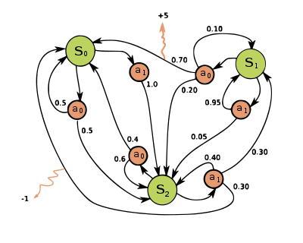
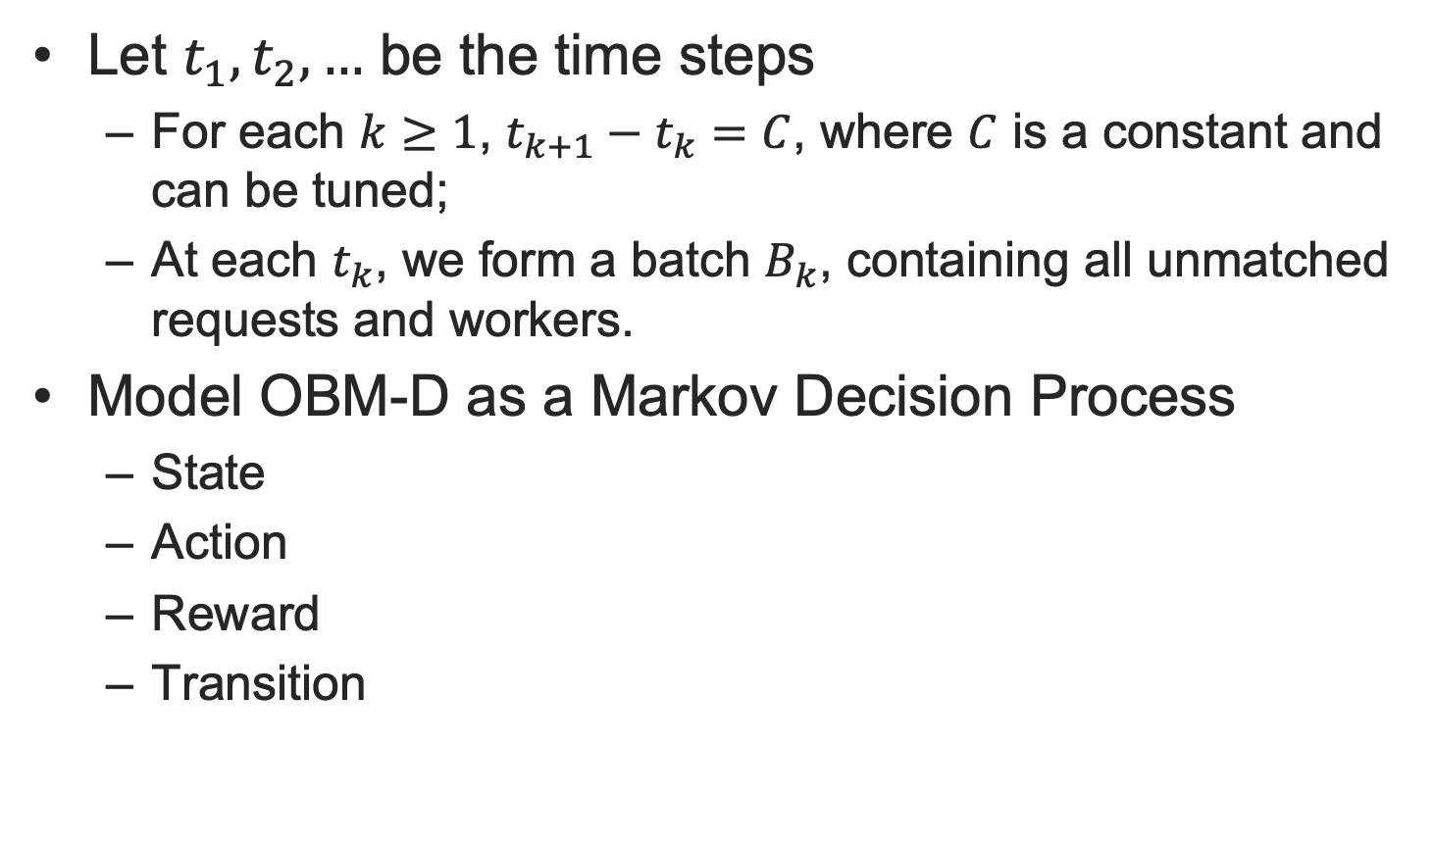
Solution
Let $t_{1},t_{2},…$ be the time steps
  For each $k≥1$, $t_{k+1}−t_{k}=C$, where $C$ is a constant and can be tuned;
  At each $t_{k}$, we form a batch $B_{k}$, containing all unmatched requests and workers.
Model OBM-D as a Markov Decision Process
  State
  Action
  Reward
  Transition
An example from Wikipedia: a simple Markov Decision Process (MDP) with three states (green circles), two actions (orange circles), and two rewards (orange arrows)
Notes:
Assume that we check and form a batch every C seconds. Now we model OBM-D as a Markov Decision Process. In Markov Decision Process, there will be many states. And after taking an action at a certain state, we transit from that state to another, and get a reward from the environment. Our goal is to maximize our accumulative rewards after a period of time. Here is a simple example of an MDP from Wikipedia. Now, we will formally define the state, action, reward, and transition probabilities of OBM-D problem in the following slides. [click]

Slide 16

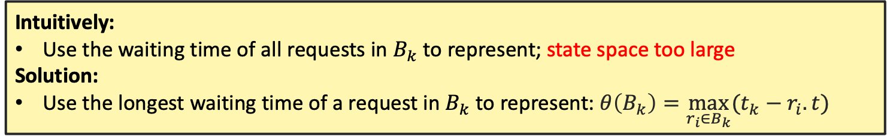
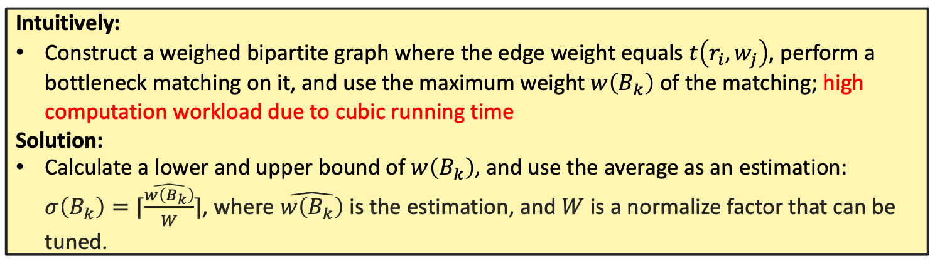
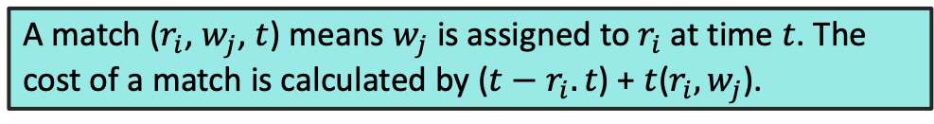
Solution
A match ($r_{i}$, $w_{j}$, $t$) means $w_{j}$ is assigned to $r_{i}$ at time $t$. The cost of a match is calculated by ($t−r_{i}.t$) + $t$($r_{i}, w_{j}$).
MDP – State
  How long the requests in batch $B_{k}$ have waited for since they arrived;
  How long the workers in batch $B_{k}$ need to prepare for before they serve the requests;
Intuitively:
Use the waiting time of all requests in $B_{k}$ to represent; state space too large
Solution:
Use the longest waiting time of a request in $B_{k}$ to represent: $θ\left(B_{k}\right)=\max_{r_{i}∈B_{k}}{(t_{k}−r_{i}.t)}$
Intuitively:
Construct a weighed bipartite graph where the edge weight equals $t\left(r_{i}, w_{j}\right)$, perform a bottleneck matching on it, and use the maximum weight $w\left(B_{k}\right)$ of the matching; high computation workload due to cubic running time
Solution:
Calculate a lower and upper bound of $w\left(B_{k}\right)$, and use the average as an estimation: $σ\left(B_{k}\right)=⌈\frac{\hat{w\left(B_{k}\right)}}{W}⌉$, where $\hat{w\left(B_{k}\right)}$ is the estimation, and $W$ is a normalize factor that can be tuned.
Notes:
For the state, We identify two types of information
One is how long the requests in Batch k have waited for since they arrive;
The other is how long the workers in Batch k need to prepare for before they serve the requests.
They are aligned with the two component of the cost of a match.
For the first type of information, intuitively, we can use the whole waiting time to represent, but the state space is too large to train the model. So, we use the longest waiting time of a request in Batch k.
For the second type of information, intuitively, we construct a weighed bipartite graph with the edge weight equal the time function between requests and workers, and perform a bottleneck matching on it, and use the bottleneck value. But computation workload is high. So we calculate a lower and upper bound of the bottleneck value, and use the average as an estimation.

Slide 17
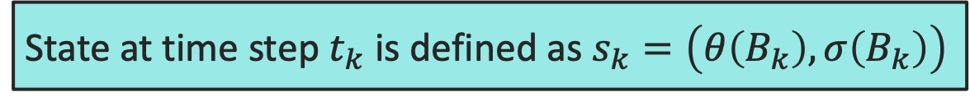
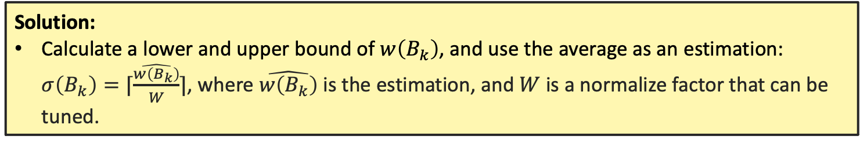
Solution
A match ($r_{i}$, $w_{j}$, $t$) means $w_{j}$ is assigned to $r_{i}$ at time $t$. The cost of a match is calculated by ($t−r_{i}.t$) + $t$($r_{i}, w_{j}$).
MDP – State
  How long the requests in batch $B_{k}$ have waited for since they arrived;
  How long the workers in batch $B_{k}$ need to prepare for before they serve the requests;
Solution:
Use the longest waiting time of a request in $B_{k}$ to represent: $θ\left(B_{k}\right)=\max_{r_{i}∈B_{k}}{(t_{k}−r_{i}.t)}$
Solution:
Calculate a lower and upper bound of $w\left(B_{k}\right)$, and use the average as an estimation: $σ\left(B_{k}\right)=⌈\frac{\hat{w\left(B_{k}\right)}}{W}⌉$, where $\hat{w\left(B_{k}\right)}$ is the estimation, and $W$ is a normalize factor that can be tuned.
State at time step $t_{k}$ is defined as $s_{k}=\left(θ\left(B_{k}\right), σ\left(B_{k}\right)\right)$
Notes:
So, the state is a defined as a 2-dimension vector, in which the first element \theta of Batch k is to represent the longest waiting time of a request in the batch, and the second element \sigma of Batch k is an estimation of how long the workers in the batch need to prepare for before they serve the requests. [click]

Slide 18
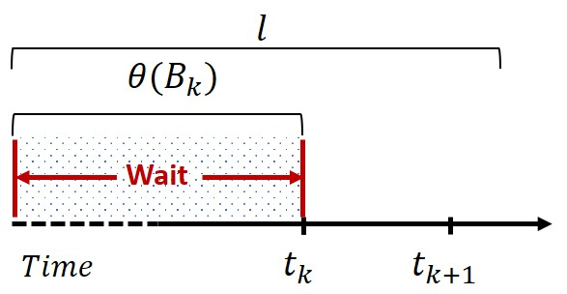
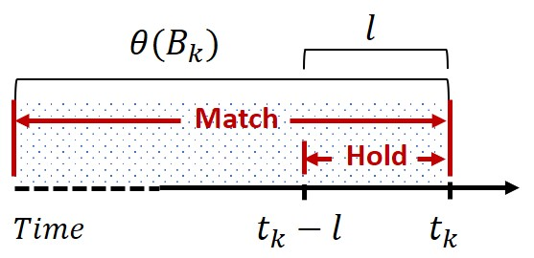

Solution
MDP – Action
  Decide whether to perform matching;
  If yes, decide which matches to hold or finalize;
$l∈[0,D]$ is the action, where $D$ is a hyperparameter that can be tuned.
Case 1 (wait): $l >θ\left(B_{k}\right).$
Don’t perform matching;
Wait till the next time step;
Case 2 (match & hold): $l≤θ\left(B_{k}\right).$
Perform matching;
Hold the matches with the requests $r_{i}$ such that $t_{k}−l<r_{i}.t≤t_{k}$;
Finalize all other matches.
Notes:
Given a state at a certain time step, we need to decide two actions. One is to decide match or not; If yes, we also need to decide which to hold, and which to finalize. We achieve this goal by using only one value L. There are two cases.
In case 1, L is larger than \theta of Batch k, as shown in the first figure. We do nothing at current time step and wait till the next.
In case 2, L is less or equal to \theta of Batch k, as shown in the second figure. We match here, and we hold the requests whose appearing time is within the "Hold" range in the figure. And finalize all other matches.
We will recalculate the state after taking an action. [click]

Slide 19


Solution
MDP – Reward
  Calculate the bottleneck $c_{k}$ till now;
$c_{k}$ (resp. $c_{k+1}$) is the maximum cost of a match in the matching before (resp. after) the action $a_{k}=l$ is taken. $c_{1}$ is the offline optimal result.
$cnt$ is the number of consecutive time steps where we have $l>θ\left(B_{k}\right)$ before $t_{k}$.
Case 1 (wait): $l >θ\left(B_{k}\right).$
Reward $r_{k}=−1$;
Case 2 (match & hold): $l≤θ\left(B_{k}\right).$
Reward $r_{k}=\left(c_{k}−c_{k+1}\right)+cnt$
Notes:
Based on the state and action definitions, we define the reward as follows.
First, let $c_{k}$ be the maximum cost of a match in the matching before the action $a_{k}$ is taken. And $c_{1}$ is the offline optimal result. And let $cnt$ be the number of consecutive time steps where we have L is larger than \theta of Batch k before $t_{k}$.
Thus, in case one, we define reward as minus 1. And in the other case, we define reward as $c_{k}$ minus $c_{k+1}$ plus $cnt$. [click]

Slide 20
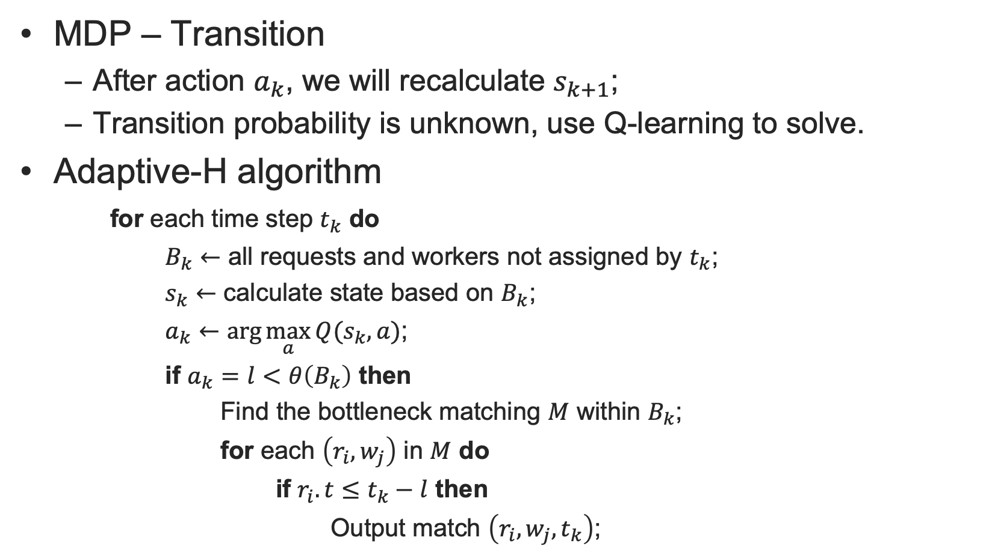
Solution
MDP – Transition
  After action $a_{k}$, we will recalculate $s_{k+1}$;
  Transition probability is unknown, use Q-learning to solve.
Adaptive-H algorithm
for each time step $t_{k}$ do
$B_{k}←$ all requests and workers not assigned by $t_{k}$;
$s_{k}←$ calculate state based on $B_{k}$;
$a_{k}←\arg{\max_{a}{Q(s_{k}, a)}}$;
if $a_{k}=l<θ\left(B_{k}\right)$ then
Find the bottleneck matching $M$ within $B_{k}$;
for each $\left(r_{i}, w_{j}\right)$ in $M$ do
if $r_{i}.t≤t_{k}−l$ then
Output match $\left(r_{i}, w_{j}, t_{k}\right)$;
Notes:
Since we cannot know the transition probability, we use Q-learning to solve this MDP. And our algorithm is presented here.
At each time step, we collect all unmatched requests and workers, and they form the Batch k; Based on the Batch k, we calculate the state.
After a Q-table lookup, we take action a_k.
If a_k less than theta of Batch k, we perform a bottleneck matching, and finalize those requests whose appearing time is less or equal than t_k minus l.

Slide 21
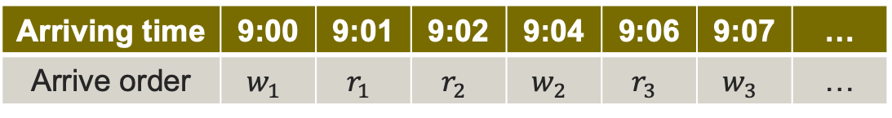
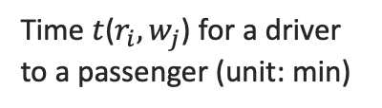
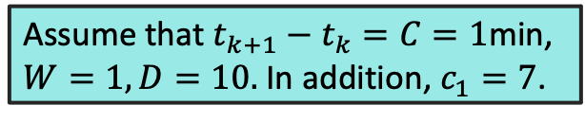
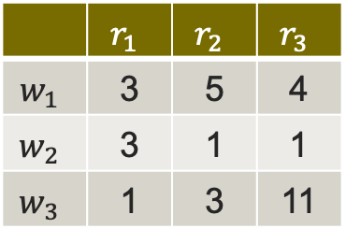
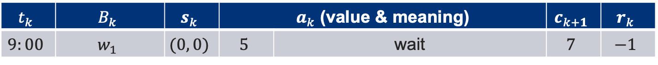
Solution
Time $t$($r_{i}, w_{j}$) for a driver to a passenger (unit: min)
Assume that $t_{k+1}−t_{k}=C=1$min, $W=1, D=10.$In addition, $c_{1}=7$.
 | $$r_{1}$$ | $$r_{2}$$ | $$r_{3}$$
$$w_{1}$$ | 3 | 5 | 4
$$w_{2}$$ | 3 | 1 | 1
$$w_{3}$$ | 1 | 3 | 11
Example
Arriving time | 9:00 | 9:01 | 9:02 | 9:04 | 9:06 | 9:07 | …
Arrive order | $$w_{1}$$ | $$r_{1}$$ | $$r_{2}$$ | $$w_{2}$$ | $$r_{3}$$ | $$w_{3}$$ | …
$$t_{k}$$ | $$B_{k}$$ | $$s_{k}$$ | $a_{k}$ (value & meaning) |  | $$c_{k+1}$$ | $$r_{k}$$
$$9:00$$ | $$w_{1}$$ | $$(0, 0)$$ | $$5$$ | wait | $$7$$ | $$−1$$
Notes:
At 9:00, worker 1 appears, we add it into the batch. Since there is no request, the state is (0, 0). the action is 5, so we do not perform matching now, and wait for the next time step. reward is minus 1. [click]

Slide 22
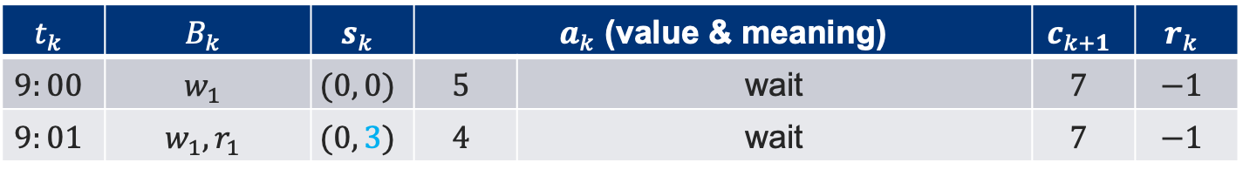
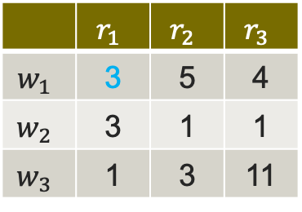
Solution
Time $t$($r_{i}, w_{j}$) for a driver to a passenger (unit: min)
Assume that $t_{k+1}−t_{k}=C=1$min, $W=1, D=10.$In addition, $c_{1}=7$.
 | $$r_{1}$$ | $$r_{2}$$ | $$r_{3}$$
$$w_{1}$$ | 3 | 5 | 4
$$w_{2}$$ | 3 | 1 | 1
$$w_{3}$$ | 1 | 3 | 11
Example
Arriving time | 9:00 | 9:01 | 9:02 | 9:04 | 9:06 | 9:07 | …
Arrive order | $$w_{1}$$ | $$r_{1}$$ | $$r_{2}$$ | $$w_{2}$$ | $$r_{3}$$ | $$w_{3}$$ | …
$$t_{k}$$ | $$B_{k}$$ | $$s_{k}$$ | $a_{k}$ (value & meaning) |  | $$c_{k+1}$$ | $$r_{k}$$
$$9:00$$ | $$w_{1}$$ | $$(0, 0)$$ | $$5$$ | wait | $$7$$ | $$−1$$
$$9:01$$ | $$w_{1},r_{1}$$ | $$(0, 3)$$ | $$4$$ | wait | $$7$$ | $$−1$$
Notes:
At 9:01. request 1 is added into the batch. The state now is (0, 3). the action is 4. So, we still wait here.

Slide 23
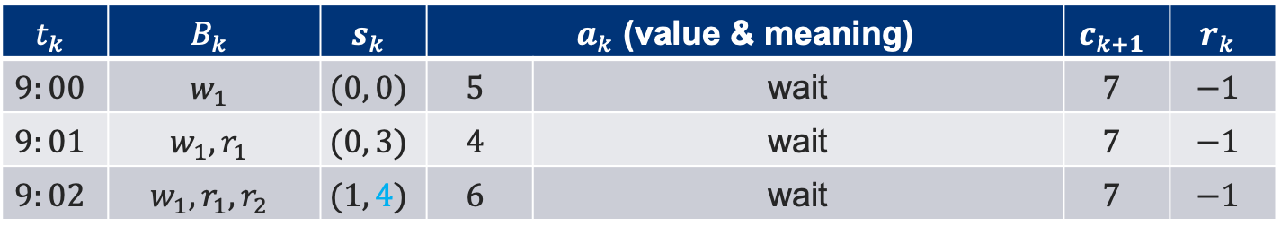
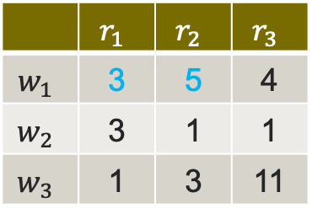
Solution
Time $t$($r_{i}, w_{j}$) for a driver to a passenger (unit: min)
Assume that $t_{k+1}−t_{k}=C=1$min, $W=1, D=10.$In addition, $c_{1}=7$.
 | $$r_{1}$$ | $$r_{2}$$ | $$r_{3}$$
$$w_{1}$$ | 3 | 5 | 4
$$w_{2}$$ | 3 | 1 | 1
$$w_{3}$$ | 1 | 3 | 11
Example
Arriving time | 9:00 | 9:01 | 9:02 | 9:04 | 9:06 | 9:07 | …
Arrive order | $$w_{1}$$ | $$r_{1}$$ | $$r_{2}$$ | $$w_{2}$$ | $$r_{3}$$ | $$w_{3}$$ | …
$$t_{k}$$ | $$B_{k}$$ | $$s_{k}$$ | $a_{k}$ (value & meaning) |  | $$c_{k+1}$$ | $$r_{k}$$
$$9:00$$ | $$w_{1}$$ | $$(0, 0)$$ | $$5$$ | wait | $$7$$ | $$−1$$
$$9:01$$ | $$w_{1},r_{1}$$ | $$(0, 3)$$ | $$4$$ | wait | $$7$$ | $$−1$$
$$9:02$$ | $$w_{1},r_{1},r_{2}$$ | $$(1, 4)$$ | $$6$$ | wait | $$7$$ | $$−1$$
Notes:
At 9:02, request 2 appears, we add it into the batch, and update the state. And the action is wait.

Slide 24
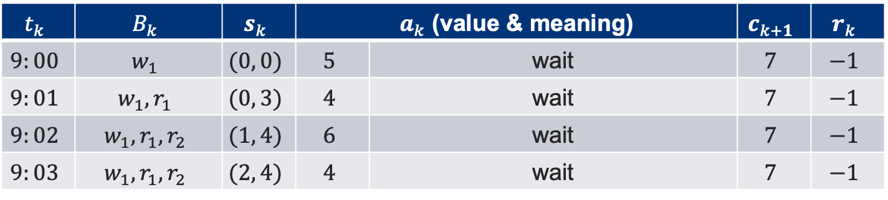
Solution
Time $t$($r_{i}, w_{j}$) for a driver to a passenger (unit: min)
Assume that $t_{k+1}−t_{k}=C=1$min, $W=1, D=10.$In addition, $c_{1}=7$.
 | $$r_{1}$$ | $$r_{2}$$ | $$r_{3}$$
$$w_{1}$$ | 3 | 5 | 4
$$w_{2}$$ | 3 | 1 | 1
$$w_{3}$$ | 1 | 3 | 11
Example
Arriving time | 9:00 | 9:01 | 9:02 | 9:04 | 9:06 | 9:07 | …
Arrive order | $$w_{1}$$ | $$r_{1}$$ | $$r_{2}$$ | $$w_{2}$$ | $$r_{3}$$ | $$w_{3}$$ | …
$$t_{k}$$ | $$B_{k}$$ | $$s_{k}$$ | $a_{k}$ (value & meaning) |  | $$c_{k+1}$$ | $$r_{k}$$
$$9:00$$ | $$w_{1}$$ | $$(0, 0)$$ | $$5$$ | wait | $$7$$ | $$−1$$
$$9:01$$ | $$w_{1},r_{1}$$ | $$(0, 3)$$ | $$4$$ | wait | $$7$$ | $$−1$$
$$9:02$$ | $$w_{1},r_{1},r_{2}$$ | $$(1, 4)$$ | $$6$$ | wait | $$7$$ | $$−1$$
$$9:03$$ | $$w_{1},r_{1},r_{2}$$ | $$(2, 4)$$ | $$4$$ | wait | $$7$$ | $$−1$$
Notes:
At 9:03, and 9:04, a_k are both larger than the \theta of Batch k, so we still wait.

Slide 25
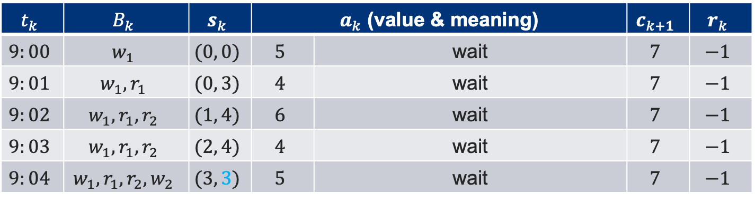
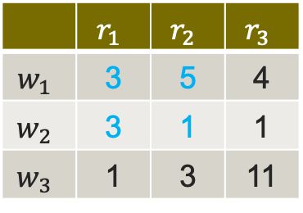
Solution
Time $t$($r_{i}, w_{j}$) for a driver to a passenger (unit: min)
Assume that $t_{k+1}−t_{k}=C=1$min, $W=1, D=10.$In addition, $c_{1}=7$.
 | $$r_{1}$$ | $$r_{2}$$ | $$r_{3}$$
$$w_{1}$$ | 3 | 5 | 4
$$w_{2}$$ | 3 | 1 | 1
$$w_{3}$$ | 1 | 3 | 11
Example
Arriving time | 9:00 | 9:01 | 9:02 | 9:04 | 9:06 | 9:07 | …
Arrive order | $$w_{1}$$ | $$r_{1}$$ | $$r_{2}$$ | $$w_{2}$$ | $$r_{3}$$ | $$w_{3}$$ | …
$$t_{k}$$ | $$B_{k}$$ | $$s_{k}$$ | $a_{k}$ (value & meaning) |  | $$c_{k+1}$$ | $$r_{k}$$
$$9:00$$ | $$w_{1}$$ | $$(0, 0)$$ | $$5$$ | wait | $$7$$ | $$−1$$
$$9:01$$ | $$w_{1},r_{1}$$ | $$(0, 3)$$ | $$4$$ | wait | $$7$$ | $$−1$$
$$9:02$$ | $$w_{1},r_{1},r_{2}$$ | $$(1, 4)$$ | $$6$$ | wait | $$7$$ | $$−1$$
$$9:03$$ | $$w_{1},r_{1},r_{2}$$ | $$(2, 4)$$ | $$4$$ | wait | $$7$$ | $$−1$$
$$9:04$$ | $$w_{1},r_{1},r_{2}, w_{2}$$ | $$(3, 3)$$ | $$5$$ | wait | $$7$$ | $$−1$$
Notes:
At 9:03, and 9:04, a_k are both larger than the \theta of Batch k, so we still wait.

Slide 26
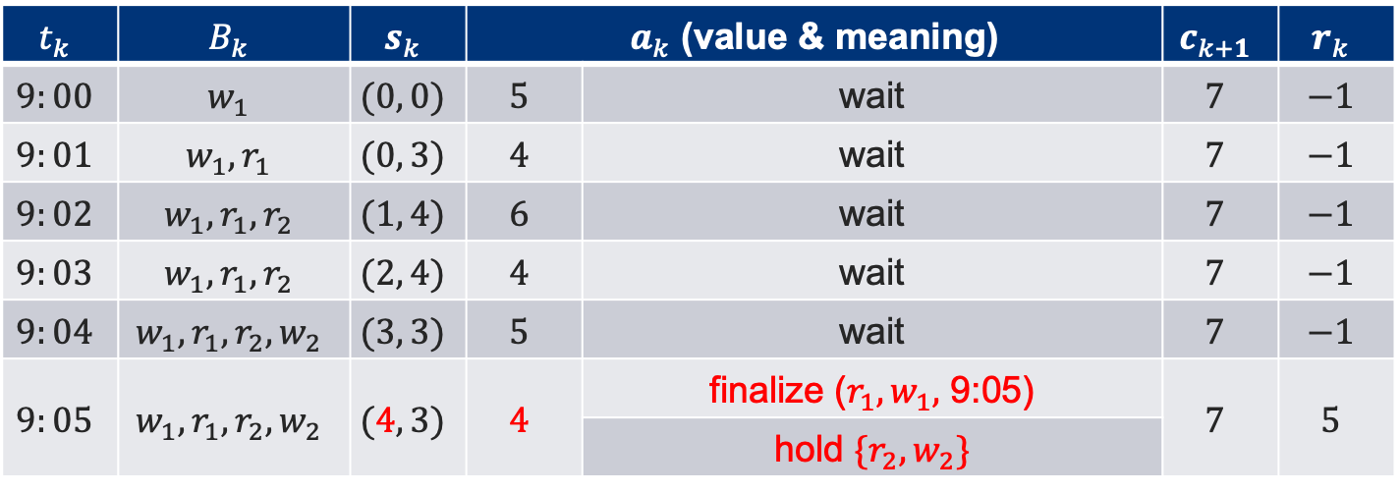
Solution
Time $t$($r_{i}, w_{j}$) for a driver to a passenger (unit: min)
Assume that $t_{k+1}−t_{k}=C=1$min, $W=1, D=10.$In addition, $c_{1}=7$.
 | $$r_{1}$$ | $$r_{2}$$ | $$r_{3}$$
$$w_{1}$$ | 3 | 5 | 4
$$w_{2}$$ | 3 | 1 | 1
$$w_{3}$$ | 1 | 3 | 11
Example
Arriving time | 9:00 | 9:01 | 9:02 | 9:04 | 9:06 | 9:07 | …
Arrive order | $$w_{1}$$ | $$r_{1}$$ | $$r_{2}$$ | $$w_{2}$$ | $$r_{3}$$ | $$w_{3}$$ | …
$$t_{k}$$ | $$B_{k}$$ | $$s_{k}$$ | $a_{k}$ (value & meaning) |  | $$c_{k+1}$$ | $$r_{k}$$
$$9:00$$ | $$w_{1}$$ | $$(0, 0)$$ | $$5$$ | wait | $$7$$ | $$−1$$
$$9:01$$ | $$w_{1},r_{1}$$ | $$(0, 3)$$ | $$4$$ | wait | $$7$$ | $$−1$$
$$9:02$$ | $$w_{1},r_{1},r_{2}$$ | $$(1, 4)$$ | $$6$$ | wait | $$7$$ | $$−1$$
$$9:03$$ | $$w_{1},r_{1},r_{2}$$ | $$(2, 4)$$ | $$4$$ | wait | $$7$$ | $$−1$$
$$9:04$$ | $$w_{1},r_{1},r_{2}, w_{2}$$ | $$(3, 3)$$ | $$5$$ | wait | $$7$$ | $$−1$$
$$9:05$$ | $$w_{1},r_{1},r_{2}, w_{2}$$ | $$(4, 3)$$ | $$4$$ | finalize ($r_{1}, w_{1},$ 9:05) | $$7$$ | $$5$$
 |  |  |  | hold $\{r_{2},w_{2}\}$
Notes:
At 9:05, we need to perform a matching here since a_k equals \theta of B_k.
The reward is 5.
We need to hold the requests whose appearing time is later than 9:01, that is request 2.

Slide 27
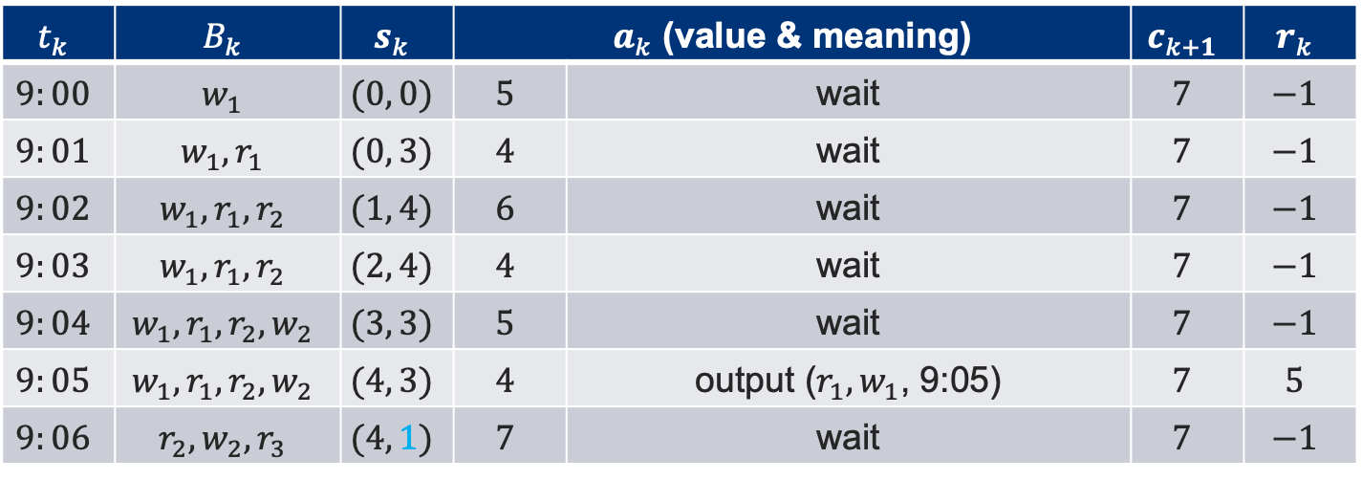
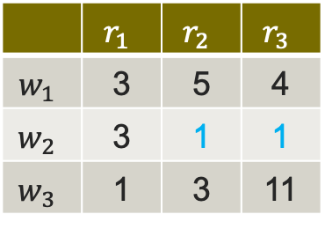
Solution
Time $t$($r_{i}, w_{j}$) for a driver to a passenger (unit: min)
Assume that $t_{k+1}−t_{k}=C=1$min, $W=1, D=10.$In addition, $c_{1}=7$.
 | $$r_{1}$$ | $$r_{2}$$ | $$r_{3}$$
$$w_{1}$$ | 3 | 5 | 4
$$w_{2}$$ | 3 | 1 | 1
$$w_{3}$$ | 1 | 3 | 11
Example
Arriving time | 9:00 | 9:01 | 9:02 | 9:04 | 9:06 | 9:07 | …
Arrive order | $$w_{1}$$ | $$r_{1}$$ | $$r_{2}$$ | $$w_{2}$$ | $$r_{3}$$ | $$w_{3}$$ | …
$$t_{k}$$ | $$B_{k}$$ | $$s_{k}$$ | $a_{k}$ (value & meaning) |  | $$c_{k+1}$$ | $$r_{k}$$
$$9:00$$ | $$w_{1}$$ | $$(0, 0)$$ | $$5$$ | wait | $$7$$ | $$−1$$
$$9:01$$ | $$w_{1},r_{1}$$ | $$(0, 3)$$ | $$4$$ | wait | $$7$$ | $$−1$$
$$9:02$$ | $$w_{1},r_{1},r_{2}$$ | $$(1, 4)$$ | $$6$$ | wait | $$7$$ | $$−1$$
$$9:03$$ | $$w_{1},r_{1},r_{2}$$ | $$(2, 4)$$ | $$4$$ | wait | $$7$$ | $$−1$$
$$9:04$$ | $$w_{1},r_{1},r_{2}, w_{2}$$ | $$(3, 3)$$ | $$5$$ | wait | $$7$$ | $$−1$$
$$9:05$$ | $$w_{1},r_{1},r_{2}, w_{2}$$ | $$(4, 3)$$ | $$4$$ | output ($r_{1}, w_{1}$, 9:05) | $$7$$ | $$5$$
$$9:06$$ | $$r_{2}, w_{2}, r_{3}$$ | $$(4, 1)$$ | $$7$$ | wait | $$7$$ | $$−1$$
Notes:
At 9:06, the algorithm also takes a waiting action.

Slide 28
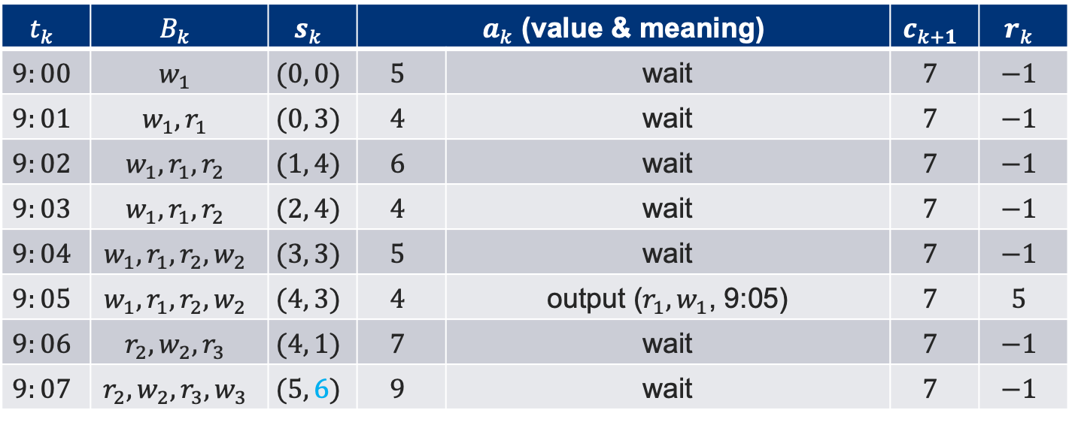
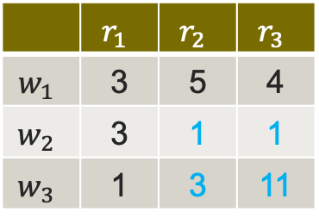
Solution
Time $t$($r_{i}, w_{j}$) for a driver to a passenger (unit: min)
Assume that $t_{k+1}−t_{k}=C=1$min, $W=1, D=10.$In addition, $c_{1}=7$.
 | $$r_{1}$$ | $$r_{2}$$ | $$r_{3}$$
$$w_{1}$$ | 3 | 5 | 4
$$w_{2}$$ | 3 | 1 | 1
$$w_{3}$$ | 1 | 3 | 11
Example
Arriving time | 9:00 | 9:01 | 9:02 | 9:04 | 9:06 | 9:07 | …
Arrive order | $$w_{1}$$ | $$r_{1}$$ | $$r_{2}$$ | $$w_{2}$$ | $$r_{3}$$ | $$w_{3}$$ | …
$$t_{k}$$ | $$B_{k}$$ | $$s_{k}$$ | $a_{k}$ (value & meaning) |  | $$c_{k+1}$$ | $$r_{k}$$
$$9:00$$ | $$w_{1}$$ | $$(0, 0)$$ | $$5$$ | wait | $$7$$ | $$−1$$
$$9:01$$ | $$w_{1},r_{1}$$ | $$(0, 3)$$ | $$4$$ | wait | $$7$$ | $$−1$$
$$9:02$$ | $$w_{1},r_{1},r_{2}$$ | $$(1, 4)$$ | $$6$$ | wait | $$7$$ | $$−1$$
$$9:03$$ | $$w_{1},r_{1},r_{2}$$ | $$(2, 4)$$ | $$4$$ | wait | $$7$$ | $$−1$$
$$9:04$$ | $$w_{1},r_{1},r_{2}, w_{2}$$ | $$(3, 3)$$ | $$5$$ | wait | $$7$$ | $$−1$$
$$9:05$$ | $$w_{1},r_{1},r_{2}, w_{2}$$ | $$(4, 3)$$ | $$4$$ | output ($r_{1}, w_{1}$, 9:05) | $$7$$ | $$5$$
$$9:06$$ | $$r_{2}, w_{2}, r_{3}$$ | $$(4, 1)$$ | $$7$$ | wait | $$7$$ | $$−1$$
$$9:07$$ | $$r_{2}, w_{2}, r_{3},w_{3}$$ | $$(5, 6)$$ | $$9$$ | wait | $$7$$ | $$−1$$
Notes:
At 9:07, worker 2 appears.

Slide 29
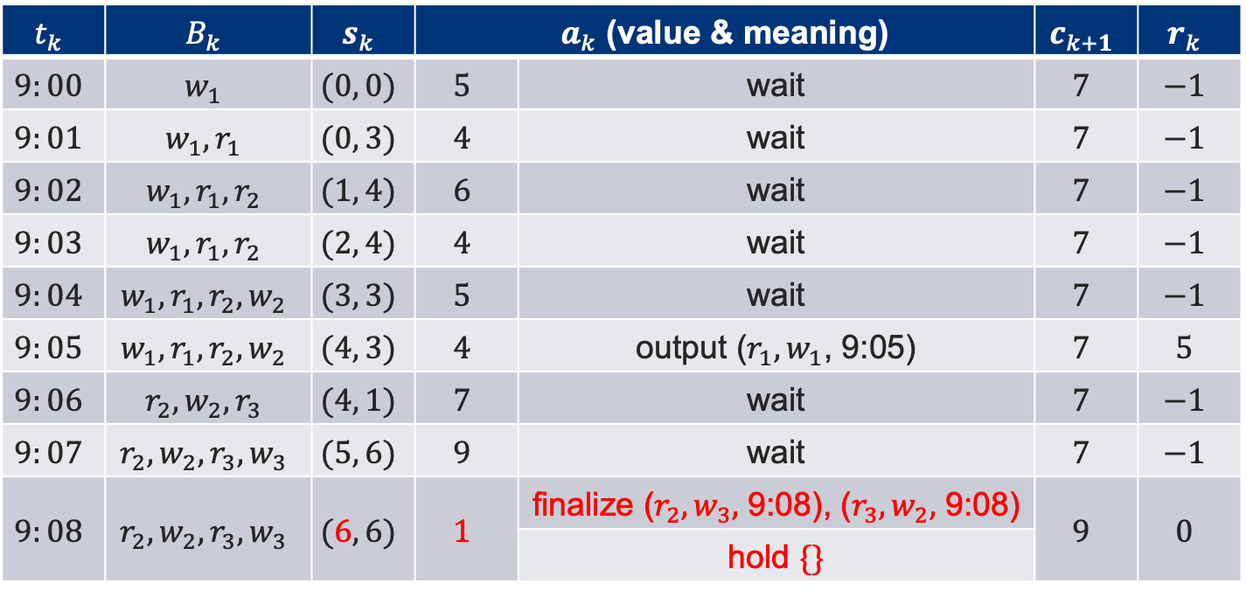

Solution
Time $t$($r_{i}, w_{j}$) for a driver to a passenger (unit: min)
Assume that $t_{k+1}−t_{k}=C=1$min, $W=1, D=10.$In addition, $c_{1}=7$.
 | $$r_{1}$$ | $$r_{2}$$ | $$r_{3}$$
$$w_{1}$$ | 4 | 5 | 4
$$w_{2}$$ | 3 | 1 | 1
$$w_{3}$$ | 1 | 3 | 11
Example
Arriving time | 9:00 | 9:01 | 9:02 | 9:04 | 9:06 | 9:07 | …
Arrive order | $$w_{1}$$ | $$r_{1}$$ | $$r_{2}$$ | $$w_{2}$$ | $$r_{3}$$ | $$w_{3}$$ | …
$$t_{k}$$ | $$B_{k}$$ | $$s_{k}$$ | $a_{k}$ (value & meaning) |  | $$c_{k+1}$$ | $$r_{k}$$
$$9:00$$ | $$w_{1}$$ | $$(0, 0)$$ | $$5$$ | wait | $$7$$ | $$−1$$
$$9:01$$ | $$w_{1},r_{1}$$ | $$(0, 3)$$ | $$4$$ | wait | $$7$$ | $$−1$$
$$9:02$$ | $$w_{1},r_{1},r_{2}$$ | $$(1, 4)$$ | $$6$$ | wait | $$7$$ | $$−1$$
$$9:03$$ | $$w_{1},r_{1},r_{2}$$ | $$(2, 4)$$ | $$4$$ | wait | $$7$$ | $$−1$$
$$9:04$$ | $$w_{1},r_{1},r_{2}, w_{2}$$ | $$(3, 3)$$ | $$5$$ | wait | $$7$$ | $$−1$$
$$9:05$$ | $$w_{1},r_{1},r_{2}, w_{2}$$ | $$(4, 3)$$ | $$4$$ | output ($r_{1}, w_{1}$, 9:05) | $$7$$ | $$5$$
$$9:06$$ | $$r_{2}, w_{2}, r_{3}$$ | $$(4, 1)$$ | $$7$$ | wait | $$7$$ | $$−1$$
$$9:07$$ | $$r_{2}, w_{2}, r_{3},w_{3}$$ | $$(5, 6)$$ | $$9$$ | wait | $$7$$ | $$−1$$
$$9:08$$ | $$r_{2}, w_{2}, r_{3}, w_{3}$$ | $$(6, 6)$$ | $$1$$ | finalize ($r_{2}, w_{3},$ 9:08), ($r_{3}, w_{2},$ 9:08) | $$9$$ | $$0$$
 |  |  |  | hold $\{\}$ | $$7$$
Notes:
At 9:08, worker 3 appears.

Slide 30
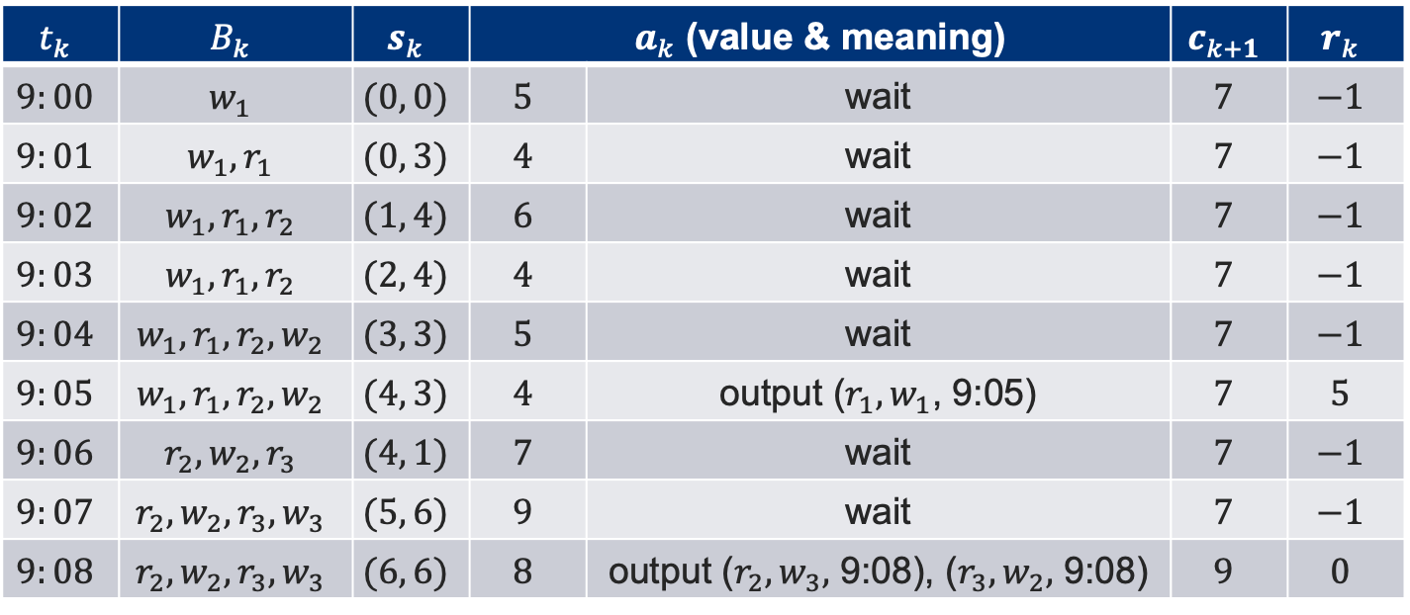
Solution
Time $t$($r_{i}, w_{j}$) for a driver to a passenger (unit: min)
Assume that $t_{k+1}−t_{k}=C=1$min, $W=1, D=10.$In addition, $c_{1}=7$.
 | $$r_{1}$$ | $$r_{2}$$ | $$r_{3}$$
$$w_{1}$$ | 3 | 5 | 4
$$w_{2}$$ | 3 | 1 | 1
$$w_{3}$$ | 1 | 3 | 11
Example
Arriving time | 9:00 | 9:01 | 9:02 | 9:04 | 9:06 | 9:07 | …
Arrive order | $$w_{1}$$ | $$r_{1}$$ | $$r_{2}$$ | $$w_{2}$$ | $$r_{3}$$ | $$w_{3}$$ | …
$$t_{k}$$ | $$B_{k}$$ | $$s_{k}$$ | $a_{k}$ (value & meaning) |  | $$c_{k+1}$$ | $$r_{k}$$
$$9:00$$ | $$w_{1}$$ | $$(0, 0)$$ | $$5$$ | wait | $$7$$ | $$−1$$
$$9:01$$ | $$w_{1},r_{1}$$ | $$(0, 3)$$ | $$4$$ | wait | $$7$$ | $$−1$$
$$9:02$$ | $$w_{1},r_{1},r_{2}$$ | $$(1, 4)$$ | $$6$$ | wait | $$7$$ | $$−1$$
$$9:03$$ | $$w_{1},r_{1},r_{2}$$ | $$(2, 4)$$ | $$4$$ | wait | $$7$$ | $$−1$$
$$9:04$$ | $$w_{1},r_{1},r_{2}, w_{2}$$ | $$(3, 3)$$ | $$5$$ | wait | $$7$$ | $$−1$$
$$9:05$$ | $$w_{1},r_{1},r_{2}, w_{2}$$ | $$(4, 3)$$ | $$4$$ | output ($r_{1}, w_{1}$, 9:05) | $$7$$ | $$5$$
$$9:06$$ | $$r_{2}, w_{2}, r_{3}$$ | $$(4, 1)$$ | $$7$$ | wait | $$7$$ | $$−1$$
$$9:07$$ | $$r_{2}, w_{2}, r_{3},w_{3}$$ | $$(5, 6)$$ | $$9$$ | wait | $$7$$ | $$−1$$
$$9:08$$ | $$r_{2}, w_{2}, r_{3}, w_{3}$$ | $$(6, 6)$$ | $$8$$ | output ($r_{2}, w_{3},$ 9:08), ($r_{3}, w_{2},$ 9:08) | $$9$$ | $$0$$
Notes:
At 9:09, the algorithm takes the second matching action.
Now, algorithm matches all requests whose appearing time earlier or equal to 9:08.
After that, c_{k+1} is updated to 10, and reward is 2.
Till now, all requests are assigned. And the bottleneck cost 10, induced by request 2.

Slide 31
Outline
Introduction
Theoretical results
Solution
Experiments
Conclusion
Notes:
Now, we present the experiments. [click]

Slide 32
Experiments
Set-up
  Datasets
    Real Dataset: Didi, Olist
    Synthetic Dataset: follow state-of-the-art¹
  Baselines
    Variable-H¹
    Fixed-H²
    RQL-Adapt³
  Metrics
    Running time
    Bottleneck cost
¹Li, Long, et al. "Spatial bottleneck minimum task assignment with time-delay.” In DASFAA 2019.
²Chen, Zhao, et al. "Minimizing maximum delay of task assignment in spatial crowdsourcing.” In ICDE 2019.
³Wang, Yansheng, et al. "Adaptive dynamic bipartite graph matching: A reinforcement learning approach." In ICDE 2019.
Notes:
We use two real datasets, Didi and Olist, and several synthetic datasets to evaluate our algorithm.
We choose three baselines to compare, in terms of running time and bottleneck cost.

Slide 33
Experiments
Results (real dataset)
Our algorithm performs the best consistently among all online algorithms.
Effectiveness: Adaptive holding strategy better than non-adaptive ones;
Efficiency: relies on how frequently the actions are performed.
Notes:
From these two figures, we find that our algorithm performs the best consistently among all online algorithms.
Effectiveness comes from the fact that adaptive holding strategy is better than non-adaptive ones. And Efficiency relies on how frequently the actions are performed.
By investigating the running statistics of the algorithms, we found that in our algorithm, the action performs less frequently than the other algorithm.

Slide 34
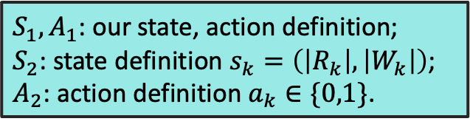

Experiments
$S_{1}, A_{1}$: our state, action definition;
$S_{2}$: state definition $s_{k}=\left(\left|R_{k}\right|, \left|W_{k}\right|\right)$;
$A_{2}$: action definition $a_{k}∈\{0,1\}$.
Ablation study (real dataset)
Effectiveness
State definition of Adaptive-H captures richer and more relevant information,
Action definition of Adaptive-H makes it possible to perform holding;
Efficiency
State $S_{2}$ is cheaper to compute than $S_{1}$;
Notes:
We also do an ablation study.
We change the states and actions with another definition, that is S_2 and A_2. The state of time step t_k is defined as a pair of number, one equal to the number of requests, and the other equal to the number of workers in the current batch.
And the action is just a binary number, 0 denoting to wait, and 1 denoting to finalize all possible matches.
Consider the effectiveness, our algorithm performs the best, which can be explained by the fact that state definition of ...... and Action ...... holding;
As for the efficiency, since S_2 is cheaper to compute than S_1, our algorithm is slightly slower than the algorithm with the combination of S_2 and A_1.

Slide 35
Outline
Introduction
Theoretical results
Solution
Experimental results
Conclusion

Slide 36
Conclusion
We propose a new, adaptive and data-driven holding strategy for solving OBM-D problem;
We provide a theoretical lower bound of competitive ratio of randomized algorithm for OBM-D problem;
We conduct extensive experiments which verify the effectiveness and efficiency of our algorithm.

Slide 37

School of Computer Science & Engineering
THANK YOU!

